Slide 1
Project Title: DIY-Drilling of Additional Borehole for EPC
Charter Template
Business Case/objectives:
Egbema Production Center (EPC) accommodates over 80 personnel on a daily basis. Water supply in EPC is from one functional borehole, water supplied from the borehole is used in EPC and piped to the nearby community. Failure of the Sumo pump in the borehole meant that the facility will be trucking water from Agip facility in Ebocha until the Sumo pump is changed out. The restoration of the only borehole to service after failure often take days. The unavailability of utility water supply in the EPC has exposed residents and visitors to hazards and hardship. There is an urgent need to drill another borehole to argument the only functional borehole.
Contract Cost for provision of 195m deep borehole by Water Facility is N8,343,500 plus $106,796.15. Findings from engagement with other Borehole contractors suggest that the team could get the borehole drilled at a cost less than N3M.
This initiative seek to drill the borehole for EPC using other competent contractors at a lower cost.
The difference in cost is about N40M.
Potential Benefits & Measurement:
The execution of this project will bring about the following benefits:
1. Improved availability of water supply in EPC
2. Eliminate/reduce trucking of water from other facilities
3.
Project Scope/Actions :
Carry out site evaluation for Borehole drilling
Scope Initiative
Secure approval and budget for Borehole drilling
Execute project
Commission
Critical Success Factors:
Budget/Funds availability
Asset Leadership Support
Manpower availability
High-level Timeline:
L0-L1: July 2018
L2:
L3:
L4:
L5: September 2018
Initiative End
Project Sponsor: Aniemeke Samuel
Implementation Lead: Digbani, Tamunofiri/Opara Darlington
Project Team: Nwalozie Collins, Dahunsi Olatunbosun, Adedokun Rasaq,Ruth Micheal, Okpeze Tina, Scholarstica, Nduka, Hart

Slide 2
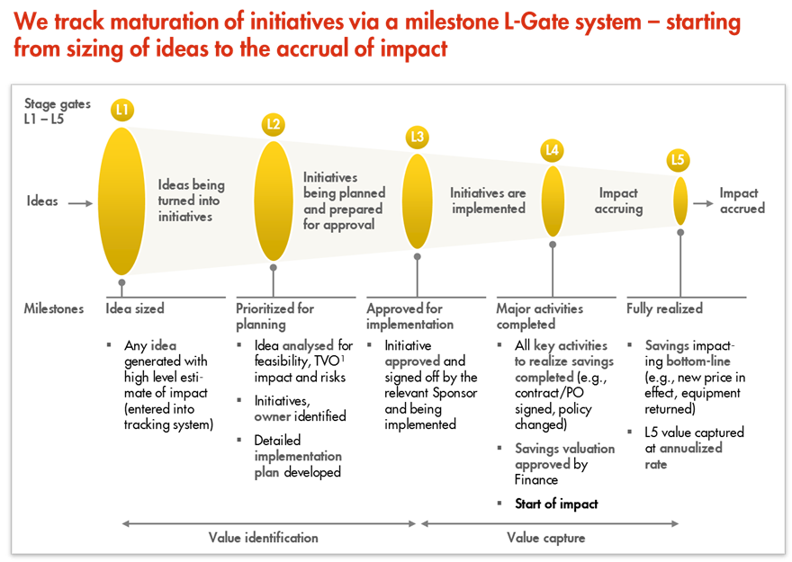
L1 – L5 Gates

